Slide 1
CHAPTER 5 Predictive Control with constraints 4 GPC simulations
Anthony Rossiter

Slide 2
Background
The previous videos demonstrated how to construct matrix inequalities which represent constraint satisfaction over the prediction horizon for a GPC algorithm.
This video will combine those constraints with a GPC optimisation in order to produce the constrained control law.
MATLAB code and simulation examples will be demonstrated.

Slide 3
GPC performance index
Chapter 2 has already shown how GPC can be expressed as the minimisation of a 2-norm cost such as J.
Output predictions are given as

Slide 4
Constraint inequalities
Constraints over the prediction horizon can be represented as:

Slide 5
GPC optimisation
GPC control law is defined by the following QP optimisation.

Slide 6
MATLAB code organisation
Define predictions
Define cost function parameters.
Define constraint equation parameters.
Set up a loop to iterate through control law computation and process update.
Control law requires a QP optimisation.
FOR NOW, ADVANCE INFORMATION ON THE TARGET IS OMITTED as are output constraints.
Main file is mpc_simulate.m
mpc_simulate_overlay.m also plots the 1st value of the unconstrained optimal input for comparison.

Slide 7
video5_4_example1.m
SISO example
Easy dynamics (1st order).
Constrained and unconstrained results different.

Slide 8
video5_4_example2.m
SISO example
Challenging dynamics.
Constrained and unconstrained results different.

Slide 9
video5_4_example3.m
MIMO example, substantial interaction.
Separate plots for signals in each loop.
Constrained and unconstrained results different.

Slide 10
Add in output constraints
INCLUSION OF OUTPUT CONSTRANTS CAN CAUSE INFEASIBILITY - THIS CODE IS NOT DESIGNED TO BE ROBUST TO SUCH CASES AS WE WANT TO KEEP IT AS SIMPLE AND TRANSPARENT AS POSSIBLE!
mpc_simulate_outputconstraints.m

Slide 11
video5_4_example4.m
SISO example, easy dynamics (1st order).
Add a sizeable disturbance around sample 20.
Cannot meet output constraints, so ignore for several samples.

Slide 12
video5_4_example5.m
SISO example, output constraints having an impact on the choice of input.
Inputs changed here to meet output constraint.

Slide 13
video5_4_example6.m
SISO example
Challenging dynamics.
With more challenging output limits, satisfying them results in a huge sacrifice to overall performance.
Output constraint is satisfied by changing the input.

Slide 14
video5_4_example7.m
MIMO example, substantial interaction. Nevertheless constraints are satisfied and targets achieved.
However, with a sizeable disturbance, feasibility not possible and a temporary violation occurs.

Slide 15
Summary
This video has demonstrated MATLAB code for implementing a constrained GPC control law.
It is shown how the QP proposes only control strategies which satisfy constraints and consequently, assuming sensible choices for the horizons, gives good behaviour.
The code is on the GPC folder.
No advance information on the target is assumed so as not to mix up different concepts.
At times one cannot satisfy both output and input constraints (for example when there is a large disturbance) – in such cases the code ignores the output constraints for as long as is necessary to give a well defined QP.

Slide 16



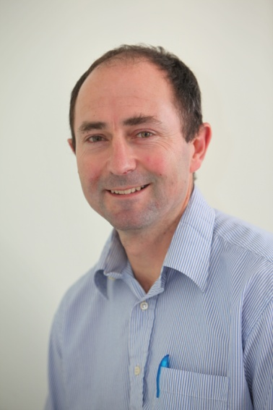
Anthony Rossiter
Department of Automatic Control and Systems Engineering
University of Sheffield
www.shef.ac.uk/acse
© 2014 University of Sheffield
This work is licensed under the Creative Commons Attribution 2.0 UK: England & Wales Licence. To view a copy of this licence, visit http://creativecommons.org/licenses/by/2.0/uk/ or send a letter to: Creative Commons, 171 Second Street, Suite 300, San Francisco, California 94105, USA.
It should be noted that some of the materials contained within this resource are subject to third party rights and any copyright notices must remain with these materials in the event of reuse or repurposing.
If there are third party images within the resource please do not remove or alter any of the copyright notices or website details shown below the image.
(Please list details of the third party rights contained within this work.
If you include your institutions logo on the cover please include reference to the fact that it is a trade mark and all copyright in that image is reserved.)

